Slide 1

Smart Green Care
An IoT system for plants’ monitoring and caring

Slide 2

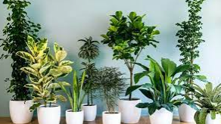


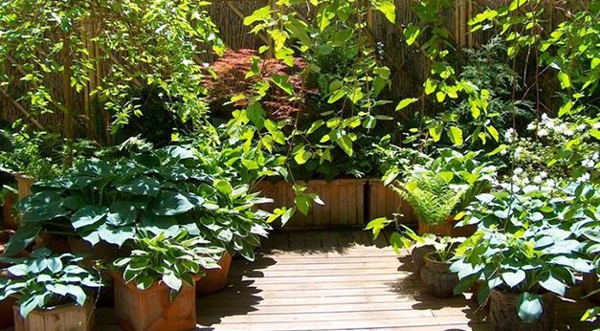

Objective
The system arise from the needs of taking care of vegetation both indoor and outdoor, reducing the minimizing human intervention

Slide 3
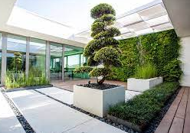

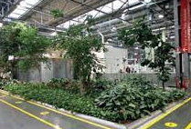
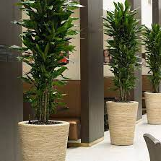
Objective
Even inside some companies the maintenance can be reduced with this approach

Slide 4
Objective
Even in some companies the maneintance can be reduced with this approach

Slide 5
What are you gonna get?
A kit of sensors for every plants to measure temperature, soil humidity, air humidity, water level and vitality index
A Cloud service able to process the information provided and making decisions about the irragation modalities
All the data are visible by the users and they can interact both via mobile and web app
In case of outdoor plants weather information are collected from a reliable forecasts service
Whatsapp alert messages are send to the users in case of critical situations

Slide 6
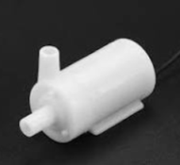
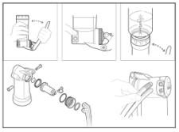
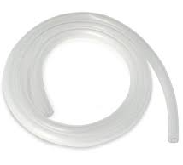

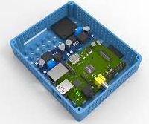
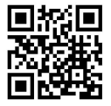
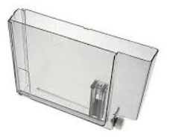
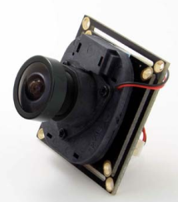

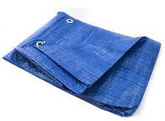
Kit unboxing

Slide 7
Kit unboxing
Electronics box:
Acquistion
Elaboration
Connectivity
Actuation
Sensing
Camera:
Plant Vitality

Slide 8
Kit unboxing
Water Pump
Tube
Water Container
(Many Sizes)
Protective Sheet
(Optional)

Slide 9
Kit unboxing
Instructions Manual
QR-Code

Slide 10
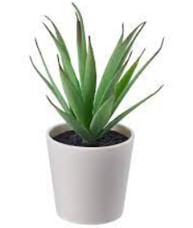
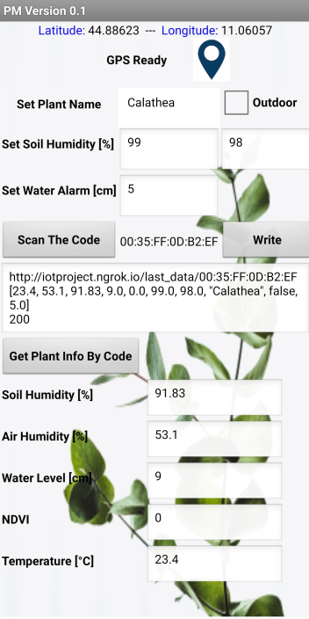
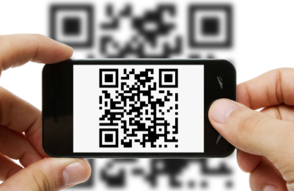

Smartphone App
Functionalities:
Add New Plant
Modify Parameters
Plant Name
Plant Type: Outdoor vs Indoor
Soil Humidity Thresholds for Pump Activations
Assign Geographic Coordinates for Outdoor Plants
Read Plant Info

Slide 11



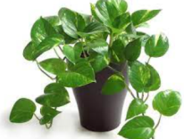







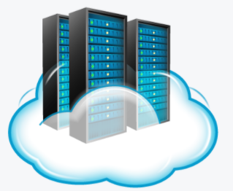
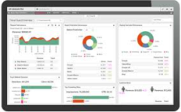


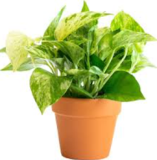


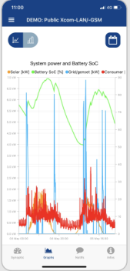
System Architecture
Data Systems
IoT Gateway
IoT Devices

Slide 12
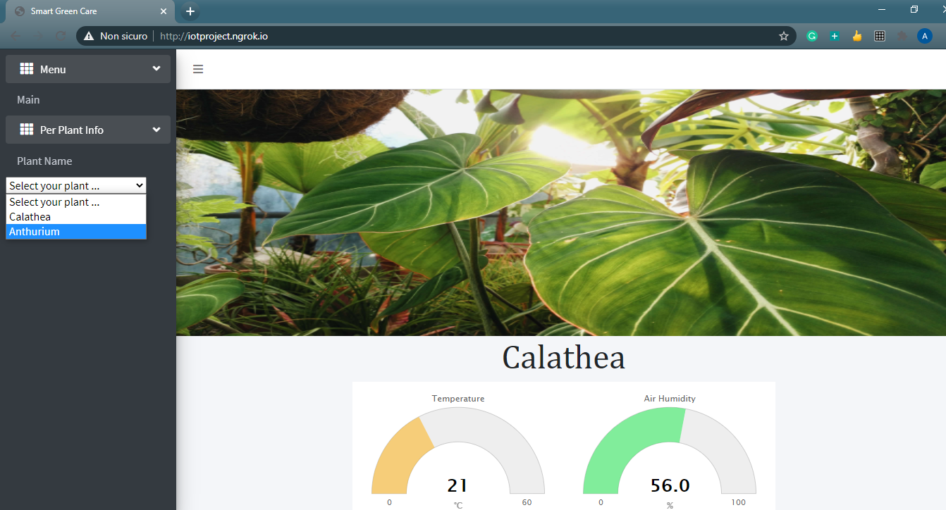
Web Application

Slide 13
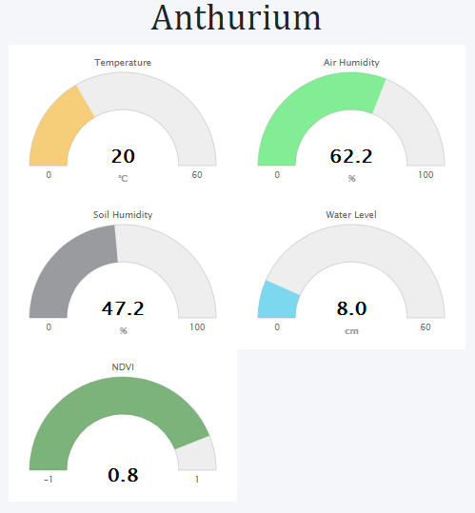
Web Application
Live gauges allows to display real-time data about sensors activities

Slide 14
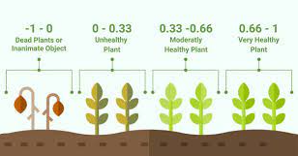
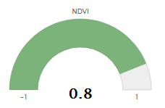
Normalized Difference Vegetation Index
Monitor of the health plant status exploiting camera images and analysing near-infrared reflectance
The index returned is called Normalized Difference Vegetation Index or NDVI for short. It is one of the most widely use health indicator in botanics.

Slide 15
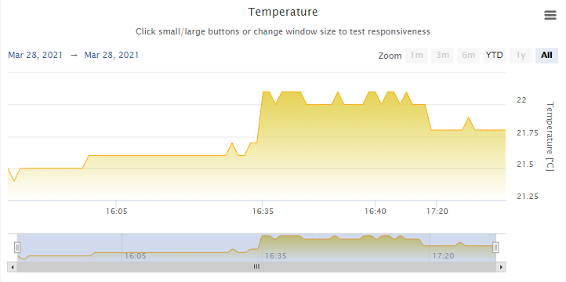
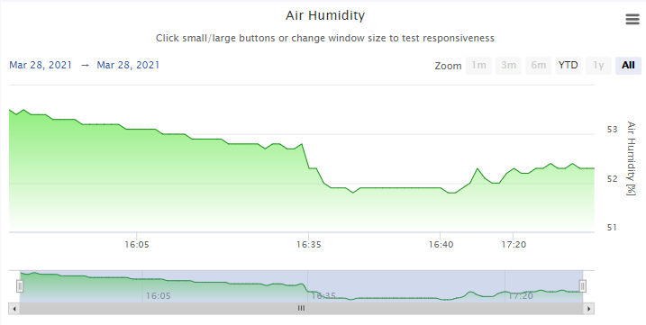
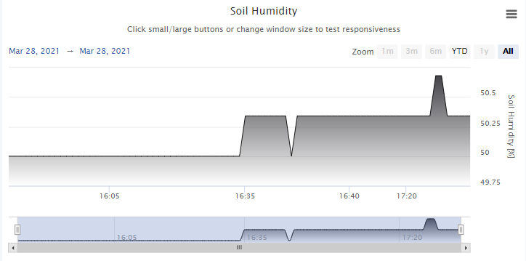
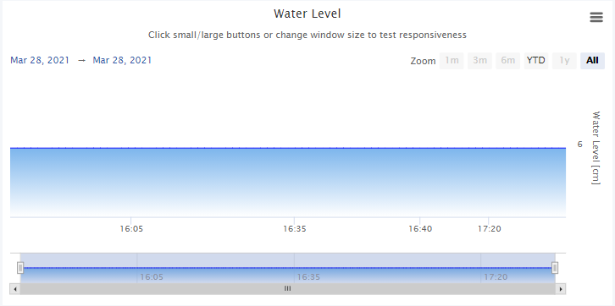
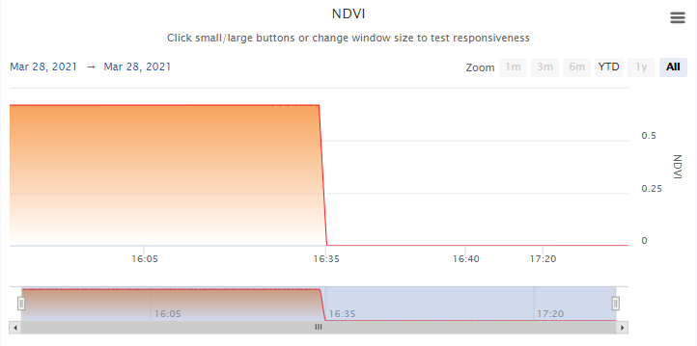
Web Application
Plant sensors history are displayed by means of zooming interactive charts

Slide 16
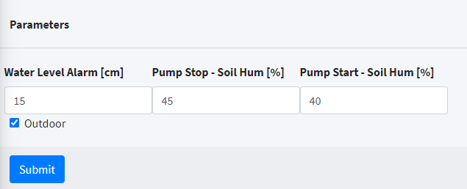
Web Application

Slide 17

Open Weather
Open Weather gives flexibility in order to get forecast conditions specifying world coordinates; this allows to associate a given forecast for every plant, according to their geographic positions
Based on the information provided by the Open Weather Server and those associated by the user when the plant is added, the web server can decide the modalities of the irrigation cycle

Slide 18
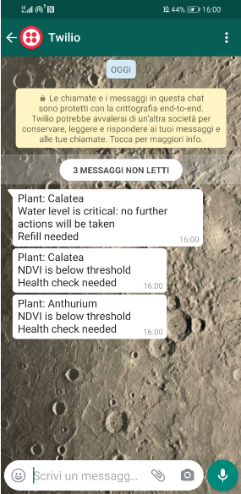

Alerting Messages
Everytime some critical conditions are triggered by the server a notification will appear on the user smartphone exploiting a cloud communication platform called Twilio
Currently, two conditions have been implemented, and are the following ones:
Water Level Scarcity
NDVI index below threshold

Slide 19
Let’s see the technical details!

Slide 20
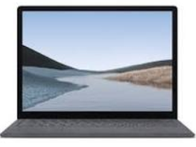
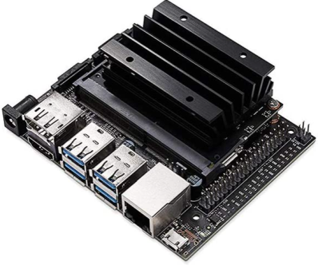
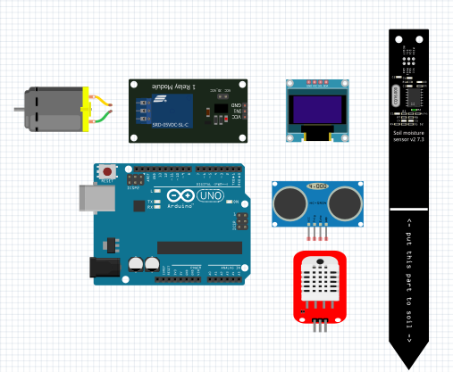

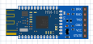
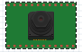

Project Details
Server/Cloud
-
My Personal Computer
Bridge
-
Nvidia Jetson Nano
Bluetooth
Arduino Microntroller and Sensors
PiNoir Camera + Blue Filter
The camera has been placed on the Bridge node
The camera acquires the panoramic view of the plants and compute a vitality index associated to each one

Slide 21
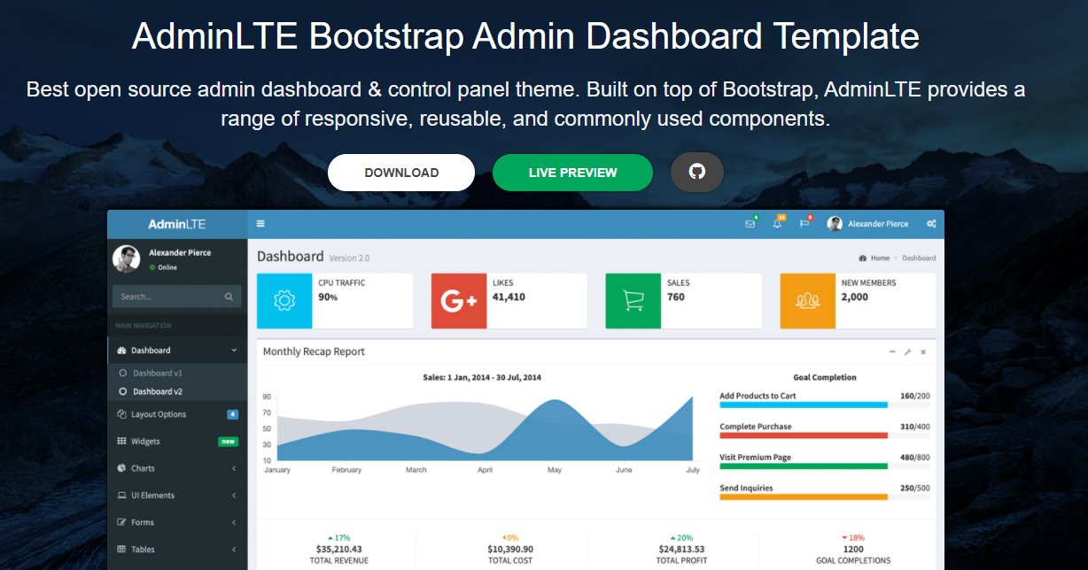
AdminLTE
The web application is based on AdminLTE build on top of Bootstrap

Slide 22
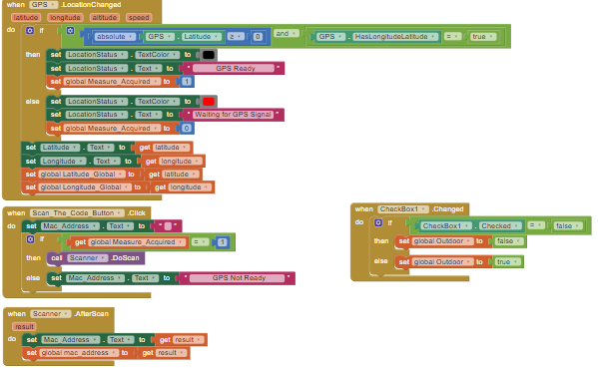
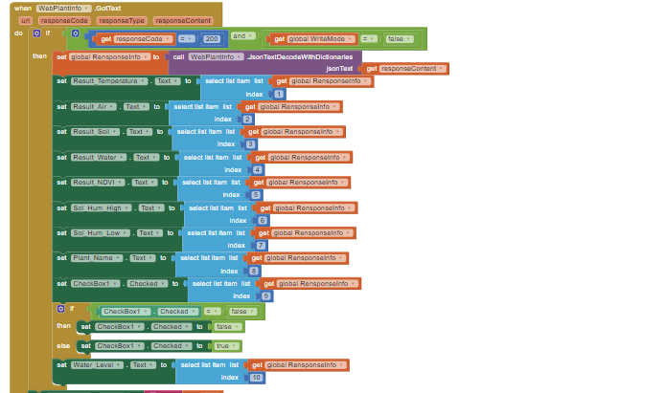
Mobile App
Mobile App has been developed with MIT App Inventor

Slide 23
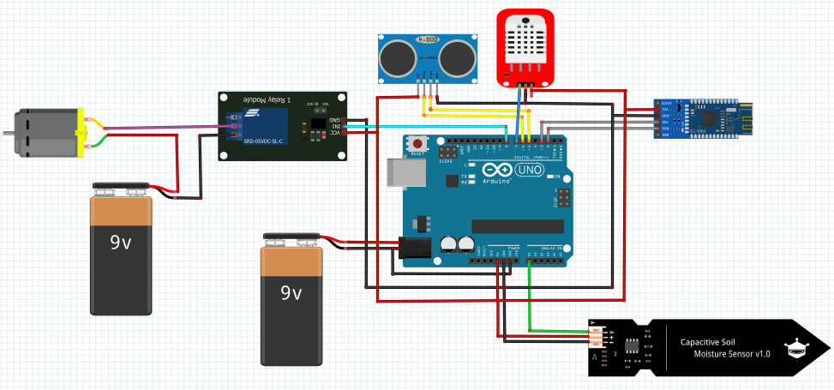
Sensors Kit - HW Schematics

Slide 24
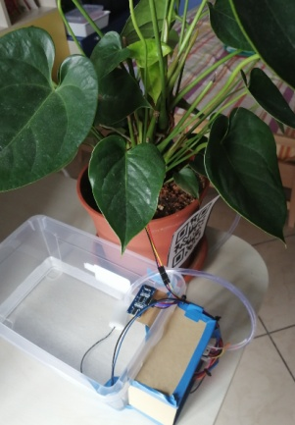
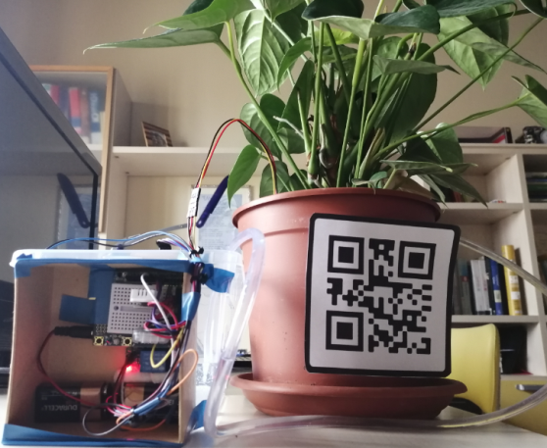
Prototype Aspect

Slide 25
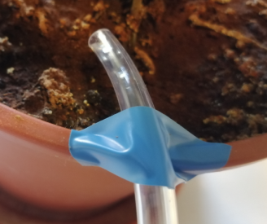
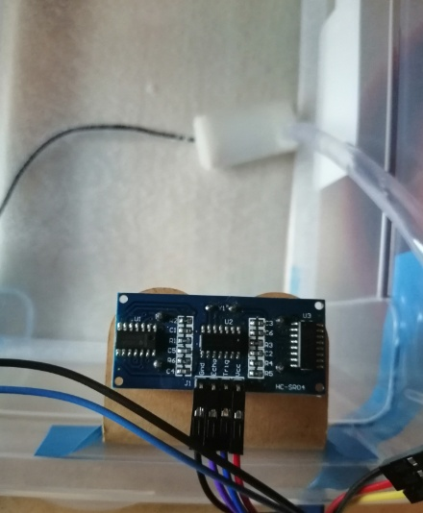
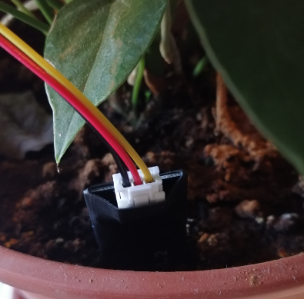
Prototype Aspect
Tube
Soil Moisture
Ultrasound and Pump

Slide 26
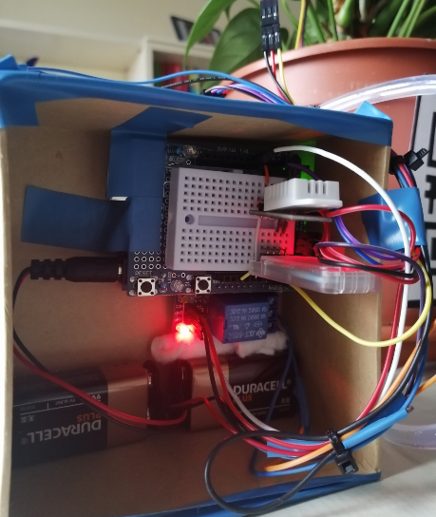
Prototype Aspect
Electronics Box

Slide 27
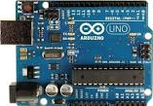
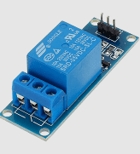
Prototype Aspect
Arduino
Relay

Slide 28
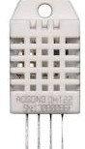

Prototype Aspect
DTH22
Air Temperature and Humidity
HM-10
Bluetooth Module

Slide 29

Prototype Aspect

Slide 30

Prototype Aspect
NVIDIA Jetson Nano
Bridge
-
Camera Acquisitions

Slide 31

Prototype Aspect
NVIDIA Jetson Nano
Bridge
-
Camera Acquisitions
PiNoir Camera
+
Blue Filter

Slide 32



Normalized Difference Vegetation Index
The normalized difference vegetation index (NDVI) is a simple graphical indicator that can be used to analyze remote sensing measurements assessing whether or not the target being observed contains live green vegetation
Photos are taken by means of a RaspberryPi Camera NoIR, where for definition the IR filter is removed, plus adding the blue filter provided in the box on the lens
The blue channel will capture mostly blue light, and the red channel will capture mostly NIR. I used blue light instead of red one for visible light

Slide 33







NDVI Acquisitions
Blue
Green
Red
BNDVI
Healthy
Unhealthy

Slide 34




Deep Learning – Mask R-CNN
Mask R-CNN
In order to isolate the plant from the scene in the attempt to measure the NDVI, a Deep Learning approach has been implemented
The architecture choose is Mask R-CNN, that is present within the DNN module of OpenCV libraries, along with a pre-trained weights of the net trained on COCO dataset
The classes selected for the semantic segmentation task are vase and potted plant
Coco Dataset

Slide 35






Mask R-CNN on Potted Plants
Potted Plant Segmentation
Source Image
Mask R-CNN
XOR
Refinement
QR-Code Reading
Mask
Vase
Segmentation

Slide 36






Mask R-CNN on Potted Plants
Potted Plant Segmentation
Source Image
Mask R-CNN
XOR
Refinement
QR-Code Reading
Mask
Vase
Segmentation

Slide 37




NDVI Final Results
However, due to light conditions, the final result can change its appearance
Therefore the acquisitions are taken at precise time of the day, exploiting the best possible scenario in term of light

Slide 38
Web Server Scheduling
Inserted a periodic routine to monitor the following main aspects:
Cycle Pump Activation Conditions
Water Level Alert
NDVI Alert
Every 5 seconds the server process the data and makes decisions
Y
Get Weather Forecasts
Is an outdoor plant?
N
Check Pump Activations
Check Water Level
Check NDVI

Slide 39
Web Server Processing
Cold Weather
OR
Raining ?
Y
N
Water Level < Water_Level_Param
AND
Air Temperature > 0?
N
Y
Soil Humiidty < Soil_Humidty_Thr_Low
AND
Water_Pump_ON == false ?
N
Soil Humiidty < Soil_Humidty_Thr_High
AND
Water_Pump_ON == true?
Y
Y
Water_Pump_ON = true
Water_Pump_ON = false

Slide 40
Web Server Processing
Cold Weather
OR
Raining ?
Y
N
Water Level < Water_Level_Param
AND
Air Temperature > 0?
N
Y
Base Logic
Soil Humiidty < Soil_Humidty_Thr_Low
AND
Water_Pump_ON == false ?
N
Soil Humiidty < Soil_Humidty_Thr_High
AND
Water_Pump_ON == true?
Y
Y
Water_Pump_ON = true
Water_Pump_ON = false

Slide 41
Web Server Processing
Frosty Weather
OR
Raining ?
Y
Outdoor
Condition
Get the info using Open Weather’s API
N
Water Level < Water_Level_Param
AND
Air Temperature > 0?
N
Y
Base Logic
Soil Humiidty < Soil_Humidty_Thr_Low
AND
Water_Pump_ON == false ?
N
Soil Humiidty < Soil_Humidty_Thr_High
AND
Water_Pump_ON == true?
Y
Y
Water_Pump_ON = true
Water_Pump_ON = false

Slide 42

Web Server Processing
Water Level > Water_Level_Param
AND
Water_Level_Alert == false ?
N
Y
N
Y
Water_Level_Alert == true?
Y
Send Whats App Message
Y
Water_Level_Alert = true
Water_Level_Alert = false

Slide 43
Web Server Processing
NDVI <= 0
AND
NDVI_Alert == false ?
N
Y
N
NDVI_Alert == true?
Y
Send Whats App Message
NDVI_Alert = true
NDVI_Alert = false

Slide 44


Smartphone App Protocol
POST Plant Data
Method: POST
Host: http://iotproject.ngrok.io
Path: /qr_code
Data: {“code”:code, “name”: name, “outdoor”:outdoor, “soil_hysteresis_high”: soil_hysteresis_high, “soil_hysteresis_low”:soil_hysteresis_low, “water_level_alarm”: water_level_alarm, “lat”:lat, “lot”: lot }
GET Plant Data
Method: GET
Host: http://iotproject.ngrok.io
Path: /last_data/mac_address
HTTP Response
json object
HTTP Get
/ qr_code
HTTP Post
/last data/mac_address

Slide 45
Bridge
The Bridge node allows to asynchronously handle the communication between the cloud and IoT nodes
When a node is added through the smartphone, scanning the QR-Code associated to it, the information retrieved from the code represents the MAC address of the bluetooth module installed; making it possible the dialogue between Bridge and plants.
For each IoT nodes an independent timing routine is deployed, whose aim is to take care of the following aspects:
Post sensors data to the Cloud
Get water paump activation status from the Cloud
Get NDVI from plant trough camera at a fix hours
Notification from IoT Nodes

Slide 46
Protocol: Bridge to Web Server
POST Sensors Data
Method: POST
Host: http://iotproject.ngrok.io
Path: /manage_sensors
Data: {“mac_address”: mac_address, “temperature”: temperature, “air_humidity”:air_humidity, “soil_humidity”: soil_humidity, “water_level”: water_level, “ndvi”:ndvi }
GET Water Pump Activation Status
Method: GET
Host: http://iotproject.ngrok.io
Path: /manage_actuators/mac_address
GET Mac Address Node
Method: GET
Host: http://iotproject.ngrok.io
Path: /qr_code
HTTP Response
json object
HTTP Get
/manage_actuators/mac_address
/ qr_code
/manage_sensors
HTTP Post

Slide 47
Bridge
Every 60 seconds - Normal Mode
Every 10 seconds - Irrigation Mode
Every 60 seconds - Normal Mode
Every 5 seconds - Irrigation Mode
Post Data to Server:
Air Humidity Avg
Air Temperature Avg
Soil Humidity Avg
Water Level Avg
NDVI
Get Data from Server:
Water Pump Activation Status
N – IoT Nodes
Every 30 seconds - Normal Mode
Every 1 seconds - Irrigation Mode
Notification from IoT Node:
Air Humidity
Air Temperature
Soil Humidity
Water Level
Get NDVI:
Compute NDVI by Camera
At a fix time of the day

Slide 48


Protocol: Bridge to IoT Node
CMD: Cycle Pump ON
When the command of pump cycle activation is received the reading sensors rate is modified to operate at faster rate
CMD: Cycle Pump OFF
Otherwise, when the command of pump cycle deactivation is received the reading sensors rate is modified to operate at lower rate

Slide 49


Protocol: IoT Node to Bridge

Slide 50


µC - FSM Water Pump Cycle

Slide 51


µC - FSM Sensors Readings

Slide 52
SW Part List
Web Server
Flask 1.1.2
Html 5
Javascript 1.7
Python 3.6.8
SQLAlchemy 1.4.6
Twilio 6.65.0
AdminLTE 3.1.0
Numpy 1.17.0
Requests 2.25.1
Ngrok
Bridge
Python 3.6.8
Bluepy 1.3.0
Futures 3.3.0
OpenCV 4.1.1
Imutils 0.5.4
Pyzbar 0.1.8
Numpy 1.13.3
Microcontroller
Arduino IDE 1.8.13
Adafruit_Sensor 1.1.4
SoftwareSerial 1.1.2
Smartphone App
MIT App Inventor

Slide 53
Thank you for your attention

Slide 54



Ngrok
Ngrok exposes local servers behind NATs and firewalls to the public internet over secure tunnels
Ngrok cloud service accepts traffic on a public address
Traffic is relayed through to the ngrok process running on my machine and then on to the local address I specified

